Slide 1
Small Area Estimation with geospatial data using simpler approaches
David Newhouse
Senior Economist
Development Economics Data Group
January 20, 2025

Slide 2
Background
Household surveys are a critical source of data for socioeconomic measurement
But typically cover a limited set of enumeration areas
Estimates are often too unreliable to publish for small areas
We can understand our world better, at lower cost, by augmenting sample surveys with publicly available geospatial data

Slide 3
Background
Geospatial data is:
Always on
Geographically comprehensive (no selection bias)
Very good at measuring population density, which is correlated with many (but not all) socioeconomic outcomes of interest
Often freely available (both raw imagery and useful indicators)

Slide 4
Examples of freely available geospatial indicators
Variable | Source | Resolution | Year
Population structure | WorldPop | 100 m | 2021
Population density | WorldPop | 100 m | 2021
Temperature | TerraClimate | 4 km | 2023
Palmer Draught Severity Index (PSDI) | TerraClimate | 4 km | 2023
Distance to major roads (OSM) | WorldPop, Open Streetmap | 100 m | Current
Radiance of night-time lights | VIIRS | 500 m | 2024
Net primary production | Terra net (NASA) | 500 m | 2024
Rainfall | Climate Hazards Group InfraRed Precipitation with Station data (CHIRPS) | 5.5 km | 2024
Elevation | Copernicus Global Elevation Product | 30 m | 2018
Cellphone tower count | The OpenCell ID project | 1 km | Current
Years since change to impervious surface | Tsinghua via Google Earth Engine | 30 m | 2018
Building polygons | Worldpop | 100 m | 2021
Coefficient of variation on buildings | Worldpop | 100 m | 2021
Land cover classifications | Impact Observatory, Microsoft, and ESRI | 100 m | 2024

Slide 5
Potential applications of data integration
Small area estimation (more precise and disaggregated estimates)
“Nowcasting” (more up to date estimates)
Survey data quality assessment
Additional insight from linking disparate data sources
Long tradition of SAE with census data
But recent census data may not exist or may be difficult to obtain
Geospatial data can partially substitute
Why not combine data sources routinely?
As long as benefits of reducing sample error outweigh model error and improves on sample survey data alone

Slide 6
Nowcasting is hard
Prediction across time is much more difficult than prediction across space
Economic changes may not be completely visible from the sky
Lack of publicly available indicators on
Building changes / construction
Agricultural crops and yields
Existing imagery may be better able to predict economic changes over longer term than shorter term

Slide 7
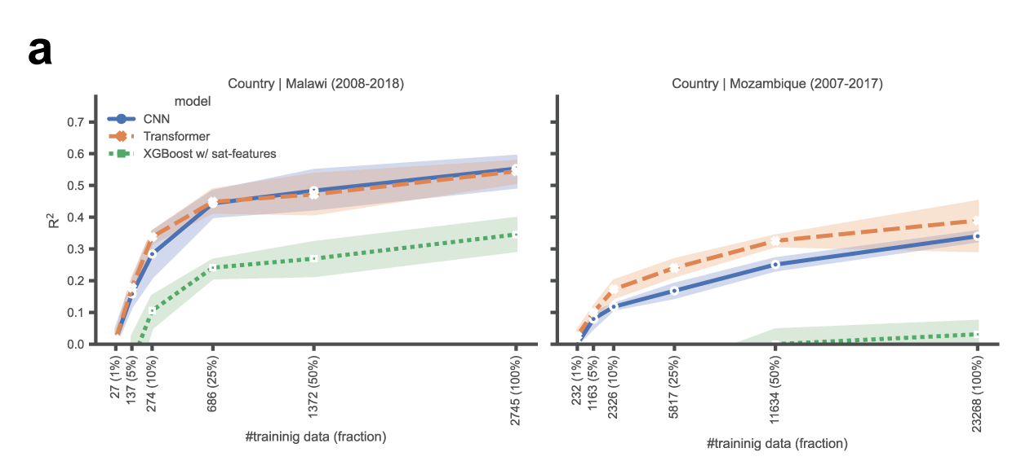
Nowcasting is hard
How well can imagery predict changes in asset index?
Link 4.5 by 4.5 km images to two census rounds a decade apart in Malawi and Mozambique
Uses more complex deep learning methods
Horizontal axis reflects different sample sizes for model training
R²~ 0.5 for Malawi and ~0.3 for Mozambique in best case when training on all images with most complex methods
Source: Zheng et al, forthcoming

Slide 8
Focus on small area estimation
How well does geospatial SAE work?
How much does it improve on direct survey estimates
What does that depend on?
How to do geospatial SAE?
Pros and cons of different models and methods?
What tools are (or will be soon) available?

Slide 9
For poverty estimation, simple features-based approach improves on survey estimates
Strong relationship between household welfare and population density
Enables large increases in precision of estimates
Sources: Masaki et al (2022), Newhouse et al (2023), Edochie et al (2024)
Notes: Results based on actual household survey data. Survey estimates are direct estimates, survey + geospatial are EBP estimates using a linear mixed model.

Slide 10
Geospatial SAE can sometimes enable more disaggregated reporting with same level of precision

Slide 11
How much does geospatial SAE improve on surveys?
Depends on reduction in sampling error versus introduction of model error
Model error depends on predictive power of geospatial data
Geospatial data more likely to improve on surveys when linked with survey at local level
Village or grid level
Linking can occur through village ID + shapefile or latitude/longitude + grids
When it works, geospatial SAE can be valuable
For poverty, incorporating geospatial data increases the precision of small area estimates by a factor of 3 to 7, depending on the context and indicator
Poverty and welfare systematically correlated with population density
Potential for millions of dollars of benefits at negligible cost

Slide 12
What methods can be used?
Linear mixed models (EBP) with features
Design-consistent – estimates converge to true values as sample size increases
Substantial evidence of improvement on direct estimates in many cases
Poorly suited for highly local estimates due to restrictive functional form
Tree-based machine learning (Xgboost) with features
Some evidence that performance is similar to linear mixed models for more aggregate estimates
Predictions can be reasonably accurate at highly disaggregated levels given sufficient training data (Gualavisi and Newhouse, 2024, Zheng et al (forthcoming)
Deep learning with raw imagery and features
Most accurate estimates at highly granular level
Difficult and resource-intensive

Slide 13
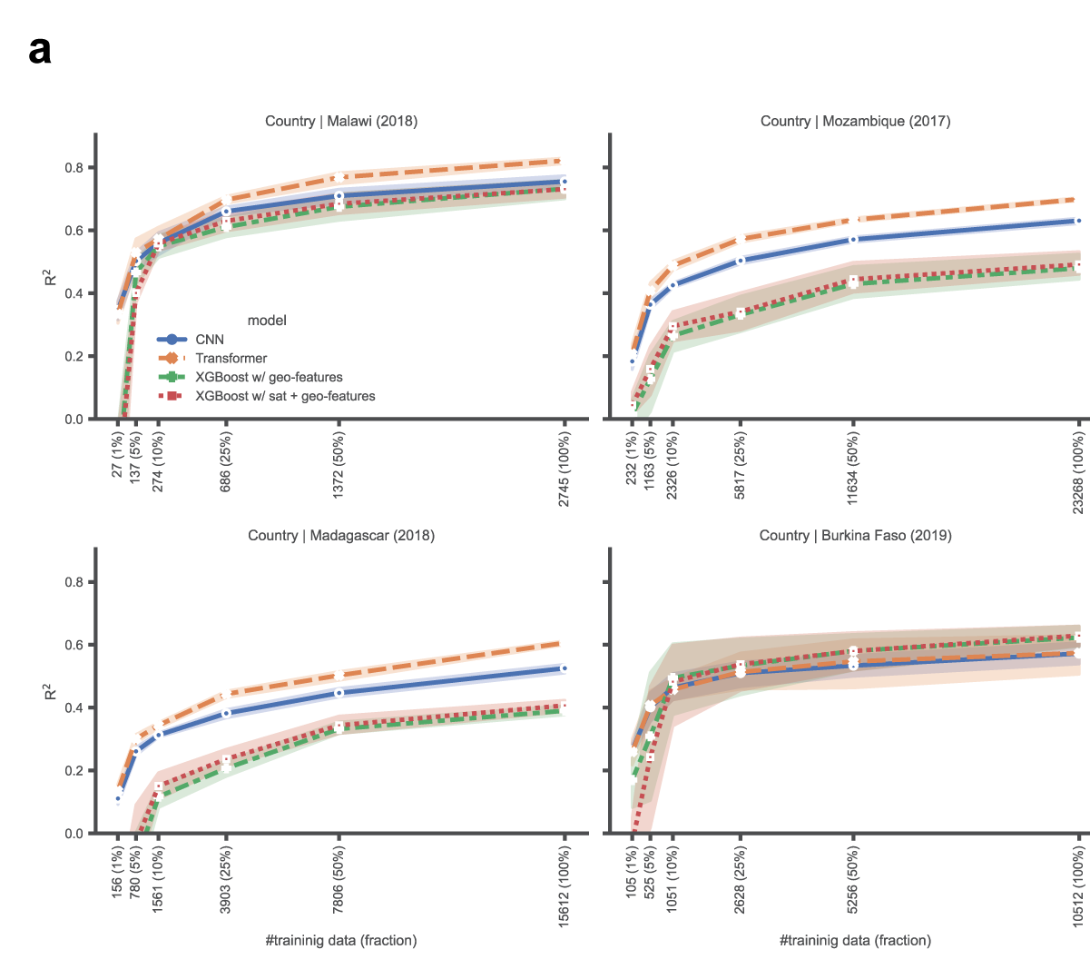
Transformer models well-suited for hyperlocal prediction
Source: Zheng et al, forthcoming

Slide 14
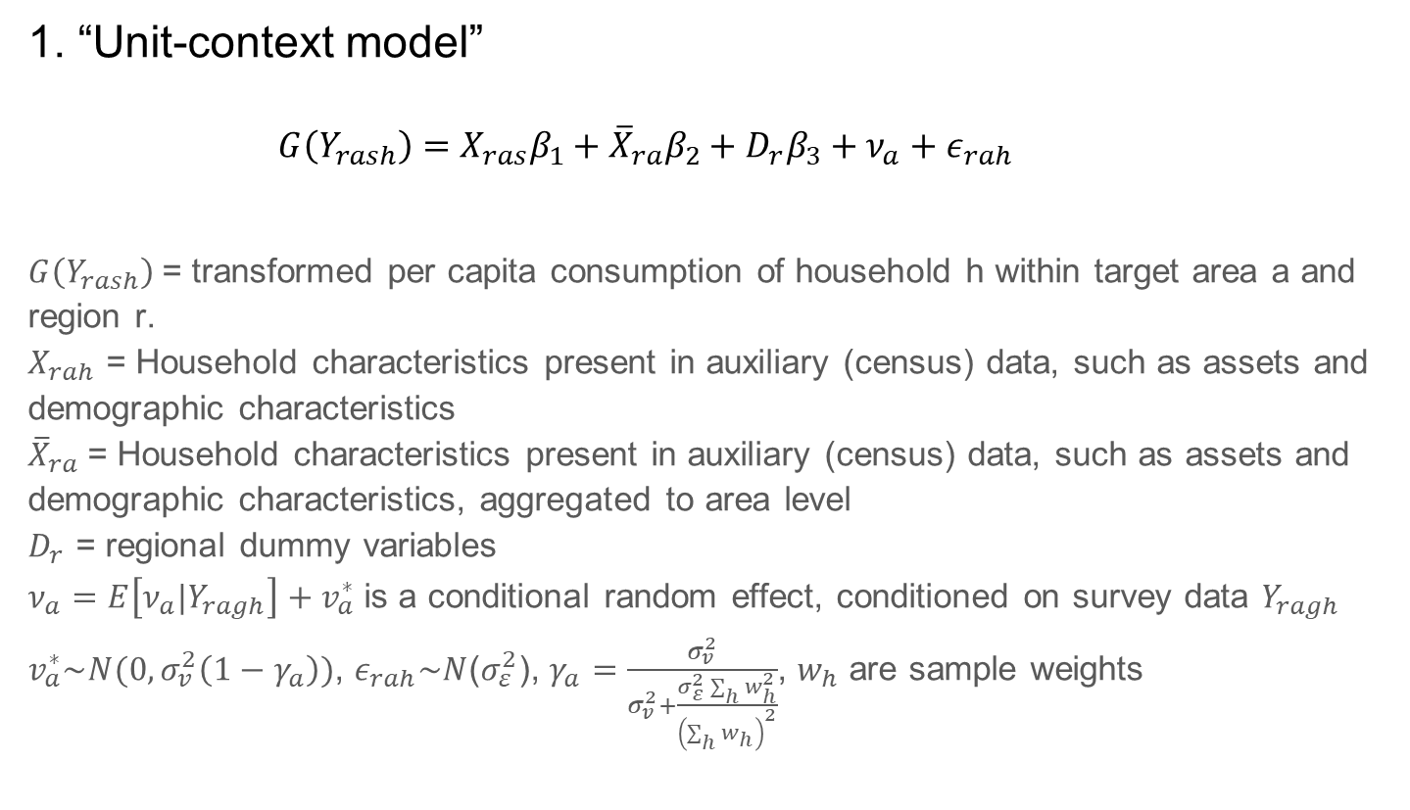
Linear mixed models: Two approaches
1. “Unit-context model”
$$G\left(Y_{rash}\right)=X_{ras}β_{1}+{\overline{X}}_{ra}β_{2}+D_{r}β_{3}+ν_{a}+ε_{rah}$$
$G\left(Y_{rash}\right)$= transformed per capita consumption of household h within target area a and region r.
$X_{rah}$ = Household characteristics present in auxiliary (census) data, such as assets and demographic characteristics
${\overline{X}}_{ra}$= Household characteristics present in auxiliary (census) data, such as assets and demographic characteristics, aggregated to area level
$D_{r}$ = regional dummy variables
$ν_{a}$ $=E\left[ν_{a}|Y_{ragh}\right]+v_{a}^{∗}$is a conditional random effect, conditioned on survey data $Y_{ragh}$
$v_{a}^{∗}\sim N(0,σ_{v}^{2}\left(1−γ_{a}\right))$, $ε_{rah}\sim N$($σ_{ε}^{2}$), $γ_{a}=\frac{σ_{v}^{2}}{σ_{v}^{2}+\frac{σ_{ε}^{2}\sum_{h}{w_{h}^{2}}}{{\left(\sum_{h}{w_{h}}\right)}^{2}}}$, $w_{h}$ are sample weights

Slide 15
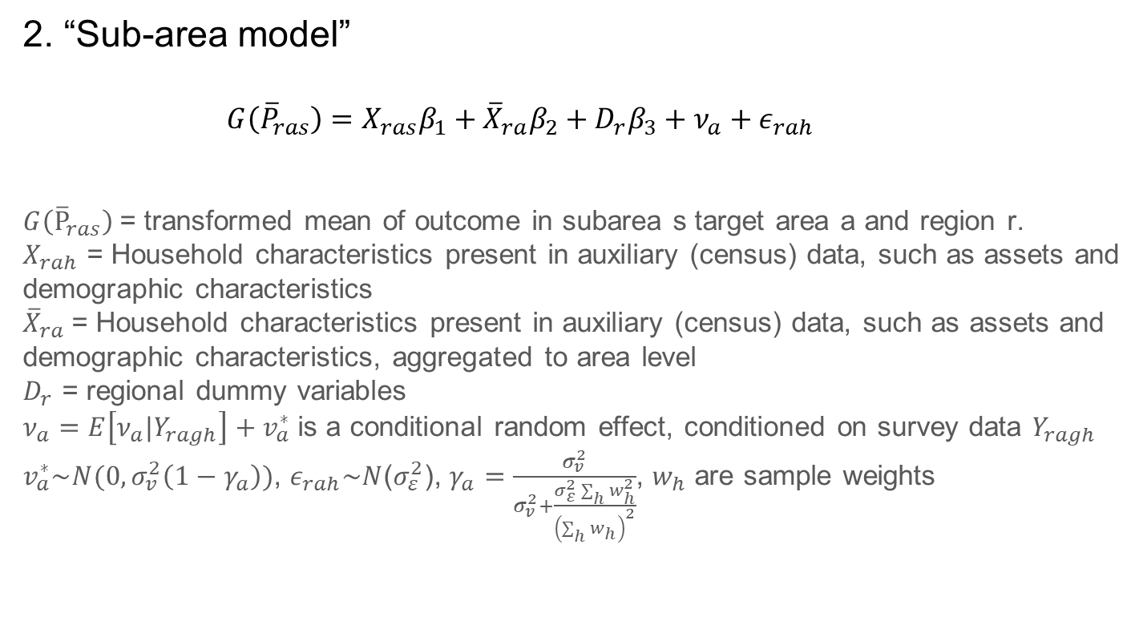
Linear mixed models: Two approaches
2. “Sub-area model”
$$G\left({\overline{P}}_{ras}\right)=X_{ras}β_{1}+{\overline{X}}_{ra}β_{2}+D_{r}β_{3}+ν_{a}+ε_{rah}$$
$G\left({\overline{P}}_{ras}\right)$= transformed mean of outcome in subarea s target area a and region r.
$X_{rah}$ = Household characteristics present in auxiliary (census) data, such as assets and demographic characteristics
${\overline{X}}_{ra}$= Household characteristics present in auxiliary (census) data, such as assets and demographic characteristics, aggregated to area level
$D_{r}$ = regional dummy variables
$ν_{a}$ $=E\left[ν_{a}|Y_{ragh}\right]+v_{a}^{∗}$is a conditional random effect, conditioned on survey data $Y_{ragh}$
$v_{a}^{∗}\sim N(0,σ_{v}^{2}\left(1−γ_{a}\right))$, $ε_{rah}\sim N$($σ_{ε}^{2}$), $γ_{a}=\frac{σ_{v}^{2}}{σ_{v}^{2}+\frac{σ_{ε}^{2}\sum_{h}{w_{h}^{2}}}{{\left(\sum_{h}{w_{h}}\right)}^{2}}}$, $w_{h}$ are sample weights

Slide 16
Pros and cons of these approaches
Unit-context models
Important to properly adjust for weights when estimating variance components
Impose constant variance for all areas, though this can be relaxed (Lahiri and Salvati, 2022)
Sub-area models
Discard information on continuous welfare by making it discrete
Are less flexible than unit-context models because don’t model underlying variable

Slide 17
Pros and cons of these approaches
In evaluations, both the unit-context nor sub-area model work well
Neither dominates the other
Both sub-area and unit-context models tend to outperform area-level models in cases where they have been tested
Aggregating geospatial data to subdistricts or districts discards important information
Differences in accuracy can be large when the sample size is small or the sample is subject to selection bias

Slide 18

How to know if geospatial SAE works?
A useful measure of predictive power for SAE is marginal area R²
$$MAR2={cor\left({\overline{y}}_{ra},{\overline{x}}_{ra}\hat{β}\right)}^{2}$$
Area $R2$ better reflects the accuracy of target area level estimates derived from the model than the standard $R2$ measure
Because the goal is ultimately to explain variation across areas

Slide 19
How to know if geospatial SAE works?
Evidence from subarea models in 1900 samples covering 19 different human capital outcomes in four low and middle income countries (Kim et al, forthcoming)
Outcomes include water and sanitation access, employment and LFP, and educational attainment
After removing ~400 cases with <0.05 MAR², in only 4 samples were SAE estimates worse than direct estimates
0.05 is not a scientific rule of thumb, but very low MAR² is a useful indicator of likely model failure.
Improvement in Pearson correlation of geospatial SAE estimates relative to direct estimates

Slide 20
Geolink R package
A “one-stop shop” to link publicly available geospatial features to survey data
Downloads geospatial data, processes it, and merges it
Links either though latitude/longitude coordinates or through administrative identifiers with shapefiles
Night-time lights, land classification, modeled population estimates, Open Streetmap points of interest, rainfall, temperature
Development version currently available on github, aiming for release in Spring 2025

Slide 21
Povmap R package
Extends EMDI (Estimating Mapping and Disaggregated Indicators)
Version 1.0 released September 2023
Version 2.0 in production, aiming for Spring 2025
Advantages of Povmap/EMDI
Very well-documented and user-friendly
Implements sample and population weights in multiple ways
Estimates both unit-level and area-level models with many recent innovations
Wide variety of transformations including adaptive transformations for improved accuracy
Automates and facilitates basic diagnostics
Parallelization of MSE estimation for increased speed
Fully open-source
Version 2.0 will implement new methodologies

Slide 22
Conclusions
Great potential for integrating survey data with geospatial data for empirical measurement in a variety of fields
Can create value worth millions of dollars
The main constraints are lack of tools, knowledge, and awareness
Both relatively simple and sophisticated methods can work well
Simple methods more appropriate for more aggregate estimates
In best case scenario, can generate estimates at one administrative level below with similar precision
Sophisticated methods better for highly disaggregated “micro-estimates”
Requires more training data
Future work can try to boost performance on small samples
Resources to help
Geolink and Povmap R packages
Primer and how-to guide on geospatial small area estimation

Slide 23
References
Edochie, I., Newhouse, D., Tzavidis, N., Schmid, T., Foster, E., Hernandez, A. L., ... & Savadogo, A. (2024). Small Area Estimation of Poverty in Four West African Countries by Integrating Survey and Geospatial Data. Journal of Official Statistics
Edochie, I., Newhouse, D., Schmid, T. and Wurz, N., 2023. Povmap: Extension to the emdi package for small area estimation. available at Comprehensive R Archive Network.
Gualavisi, M., & Newhouse, D. (2024). Integrating Survey and Geospatial Data for Geographical Targeting of the Poor and Vulnerable: Evidence from Malawi. The World Bank Economic Review
Kim, L, P. Lanjouw, J. Merfeld, and D. Newhouse (forthcoming) “Improving Estimates of Human Capital in Developing Countries: Integrating Geospatial Data into Small Area Estimation”, mimeo
Masaki, T., Newhouse, D., Silwal, A. R., Bedada, A., & Engstrom, R. (2022). Small area estimation of non-monetary poverty with geospatial data. Statistical Journal of the IAOS, 38(3), 1035-1051.
Merfeld, J., H. Chen, D. Newhouse, and P. Lahiri, “Small area estimation with geospatial data: A Primer”
Newhouse, D.L., Merfeld, J.D., Ramakrishnan, A., Swartz, T. and Lahiri, P., 2022. Small area estimation of monetary poverty in Mexico using satellite imagery and machine learning. Available at SSRN 4235976.
Tzavidis, N., Pannier, S., Rojas, N., Schmid, T., & Templ, M. (2017). emdi: An R package for estimating and mapping disaggregated indicators.
World Bank. World development report 2021: Data for better lives. The World Bank. 2021.
Zheng, Z., T, Wu, R. Lee, D. Newhouse, T. Kilic, M. Burke, S. Ermon and D. Lobell (2025), High-Resolution Spatiotemporal Measurement of Economic Well-Being in Low-Income Countries with Satellite Imagery, World Bank Policy Research Working Paper

